Slide 1
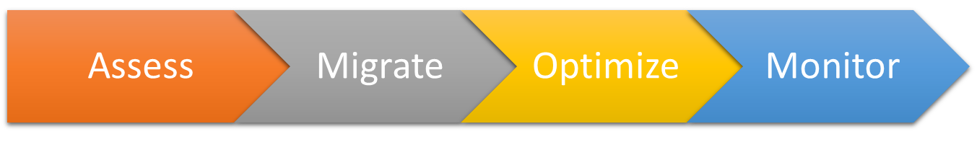



Assess
Optimize
Monitor
Migrate
Assess

Slide 2
schema
On-premises
databases
data

